Slide 1
Sentiment Analysis on AIRBNB Dataset
Team - Meep Meep

Slide 2
Team
First Name | Last Name | NetID | Position
Joel | Rosales | joelar2 | Captain
Abhinav | Abhay | aabhay3
Syed | Peerzada | syedp3
Prasanna | Muralimanohar | pkm7
Piyush | Gambhir | piyushg2
Github: https://github.com/jarosales1029/CourseProject_CS410_Meep_Meep
Note that we didn’t receive any peer feedback on the progress report on CMT

Slide 3
Problem Statement
Airbnb is a leading and rapidly growing alternative to the traditional hotel stays.
Travelers always want to choose the best option to stay
To have a great experience they often hop on to the reviews section
This process can be overwhelming for the travelers and difficult to choose the right option/stay.

Slide 4
Our Aim
Use NLP - Sentiment Analysis technique on Airbnb dataset on few cities.
Provide summarized, knowledgeable, concise result for the users.
Make it easier for the users to pick and choose the perfect stay for their vacation.
Using map and positive-negative-neutral sentiment, user can pin point on the right option.
We created a small system that can be used over and above the Airbnb website to gain insightful sentiments based on location, price, neighborhood.

Slide 5
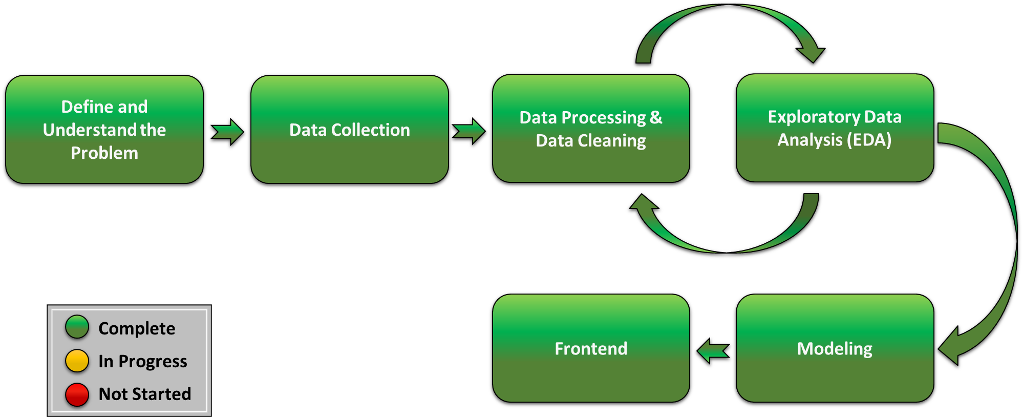
Architecture

Slide 6
Architecture Described
Define & Understand the Problem
Data Collection
Ingestion of Airbnb datasets from 8 cities, totaling 16 files
Data Processing & Data Cleaning
Exploratory Data Analysis (EDA)
Discover trends, patterns, and check assumptions
Modeling
Sentiment Analysis using VADER
Classification using three different classifiers
Frontend
Tableau: https://public.tableau.com/app/profile/piyush.gambhir/viz/Airbnb_16693106892880/AirbnbDashboard?publish=yes
Streamlit

Slide 7
Software & Tools Used
OpenRefine
Python
Jupyter notebook
Sqlite3
Streamlit.io
Tableau

Slide 8
Packages/Libraries for Jupyter Notebook - To be Installed
pandas | seaborn | matplotlib.pyplot | sqlite3
nltk | word_tokenize | stopwords | porterStemmer
sentimentIntensityAnalyzer | feature_extraction | confusion_matrix | model_selection
naive_bayes | preprocessing | warnings | MultinomialNB
accuracy_score | classification_report | plot_confusion_matrix | svm
RandomForestClassifier | scikit-learn | mlxtend
All these can be found referenced in the jupyter notebook attached. This code is run with python 3.7.7

Slide 9
Run Jupyter Notebook
Step 1: Install all the packages and libraries outlined in the above slide
Step 2: Download the raw dataset folders for each city from the link below and save them to the project root (or from the directory you are running the Jupyter Notebook)
https://uofi.box.com/s/tlfd2gd2h40nq90110u72c7p750zogqd
Step 3: Unzip the dataset folder - it will be named as “Airbnb Raw Datasets”
Step 4: You are good to run the Jupyter Notebook now ! Running Jupyter will create a Dataset_Final.csv which Streamlit and Tableau frontend will use for a data source.
Alternatively, it can also be downloaded directly from: https://uofi.box.com/s/p0uh3uijb3i7kqnmjqqypir2b8efw3el
Note: The Data Preprocessing and Data Cleaning steps take a while to complete, for your convenience the Final_Dataset.csv is available for download in Step 4. You DO NOT need to run any of the code in the Jupyter Notebook to acquire the Final_Dataset.csv.
Note: If you run the Jupyter Notebook, your Final_Dataset.csv may vary due to the random sampling of the Airbnb listings.

Slide 10
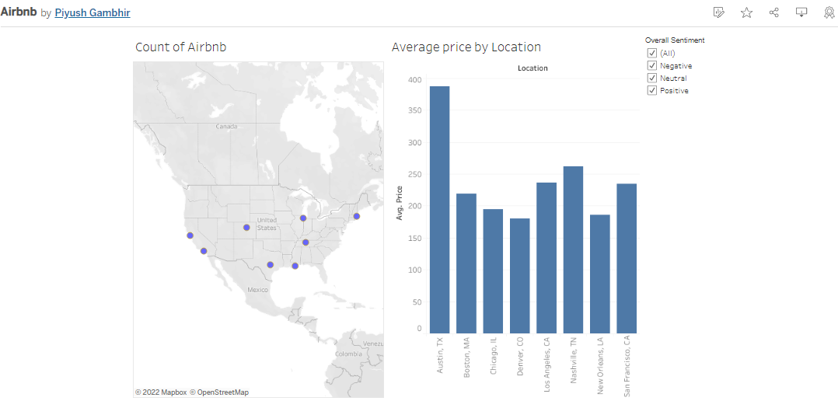
Tableau as Front End
Access to Tableau Dashboard: https://public.tableau.com/app/profile/piyush.gambhir/viz/Airbnb_16693106892880/AirbnbDashboard?publish=yes

Slide 11
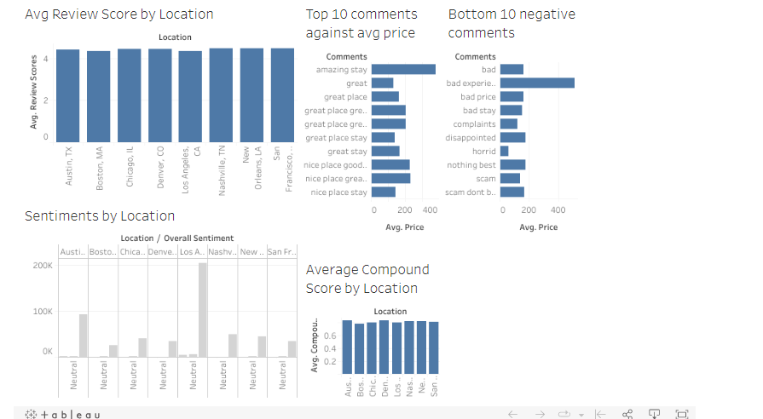
Tableau as Front End

Slide 12
Running Streamlit Front-end
Step 1: Install the required packages
Use the requirements.txt file (included) to install all required packages using this in command prompt:
pip install -r requirements.txt
Step 2: Go to the file location in command prompt and run the following command
python -m streamlit run 2_Streamlit_Frontend.py
This should automatically take you to the web browser interface for Streamlit, you may see a welcome message asking you to provide an Email address if you are interested. You may Press Enter and leave it blank.
Note: Your Antivirus may prompt you to allow the URL connection for your local Streamlit server will run.
Note: Your Local URL and Network URL will be visible in the command prompt.
Step 3: Upload the Dataset_Final.csv and click on submit. You would have already run Jupyter Notebook or downloaded directly as part of earlier instructions and that would have created a copy of Dataset_Final.csv in the root folder of the project.

Slide 13
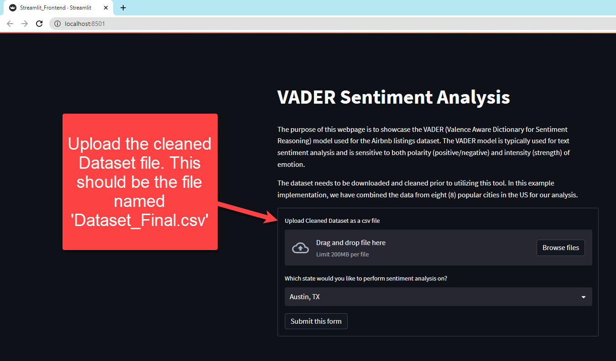
Streamlit Front-end
Note : In order to choose a different city, re-upload the Dataset_Final.csv file again, select city and Submit.

Slide 14
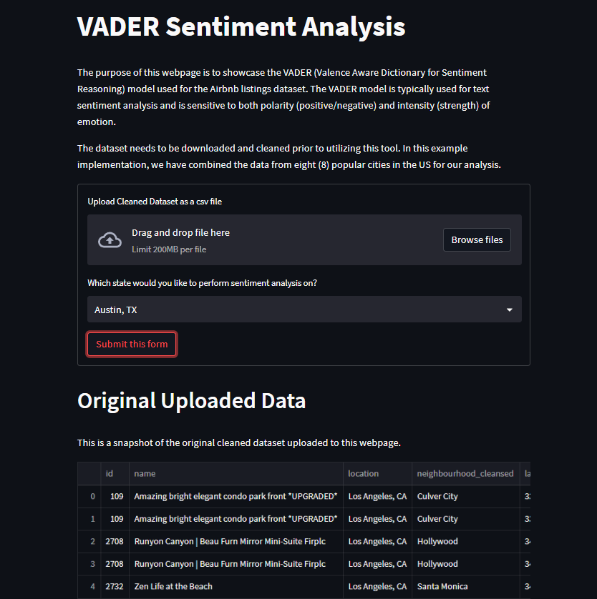
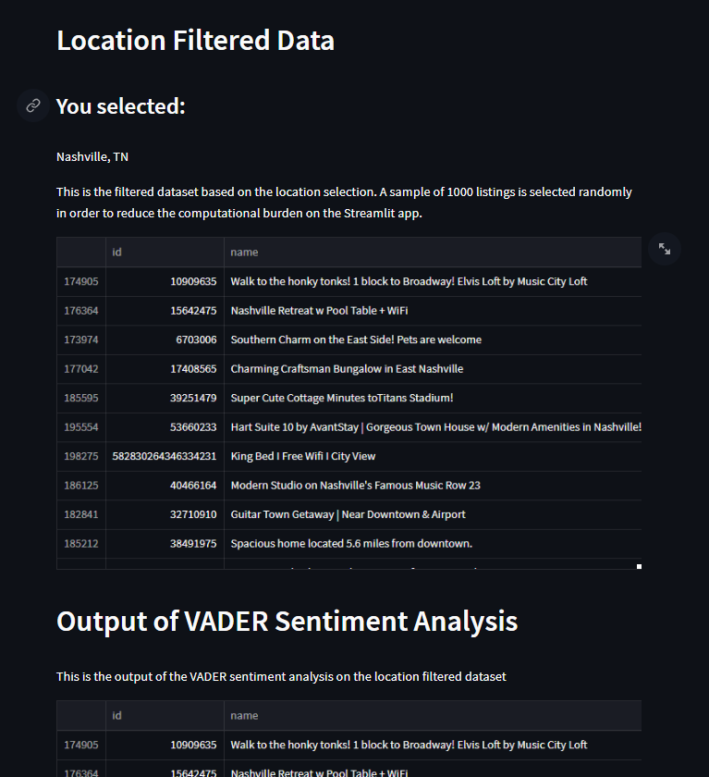
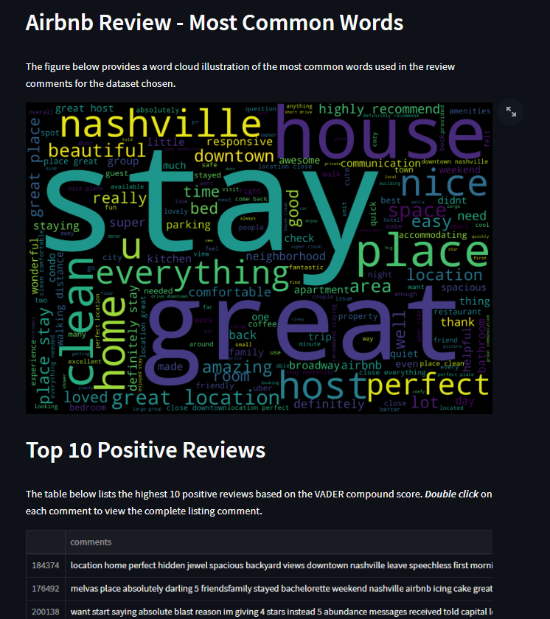
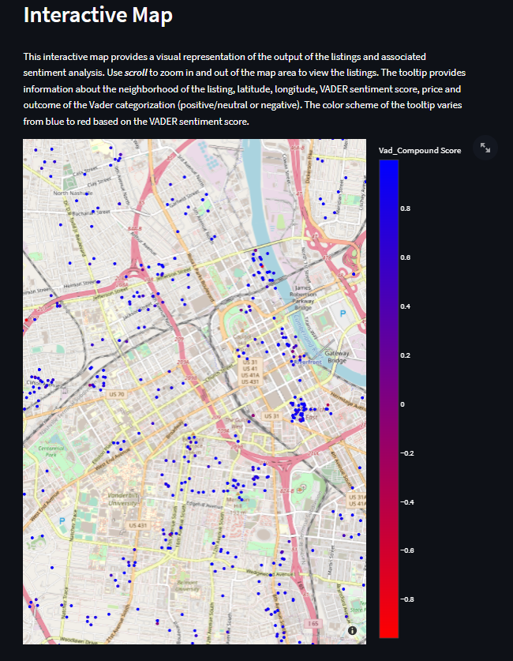
Streamlit Front-end - After Successful Selection

Slide 15
Challenges
Data cleaning took lot of time and multiple passes
OpenRefine did not work as intended for cleaning and clustering
EDA illuminated issues which we needed to implement ways to handle them in the processing and cleaning of the data
SQLite ended up not being necessary for our use case
Classification was difficult due to skewed dataset (95%+ positive reviews)
Precision, Recall and F score
Availability of Tableau license(Limited)
Streamlit.io required some learning

Slide 16
Enhancement
Applying text categorization technique to further categorize positive and negative reviews into areas by (Cleanliness, value, Space, Location etc)
Adding more attributes
Hosting application on a server
Adding more cities/countries
Improved UX on the Streamlit to handle choosing different filter without uploading the file again (Integrate with sqlite3)

Slide 17
Contributions
Task | Hours | Member | Desc
Research & Data Collection | 10 | All | Airbnb dataset downloads File Path Structure Tool Familiarity
Data Processing & Data Cleaning | 25 | Joel Abhinav Prasanna | Jupyter Notebook
Exploratory Data Analysis | 25 | All | Jupyter Notebook Python Plotting
Modeling/Sentiment Analysis | 25 | All | Vader
Classification | 35 | Syed Abhinav Piyush | Naive Bayes Support Vector Machine Random Forest Count Vectorization
Backend | 1 | Abhinav | SQLite
Frontend | 25 | Piyush Prasanna | Tableau Streamlit
Total: | 146

Slide 18
DEMO
Live Demo !!!: https://uofi.box.com/s/k577hdejew39sjz6chte2ltol40ui7f6
Github: https://github.com/jarosales1029/CourseProject_CS410_Meep_Meep

